Slide 1

MUSIC STORE Database ANALYSIS (PostgreSQL)
By Rishab Kumar
Date: 24th August 2024

Slide 2
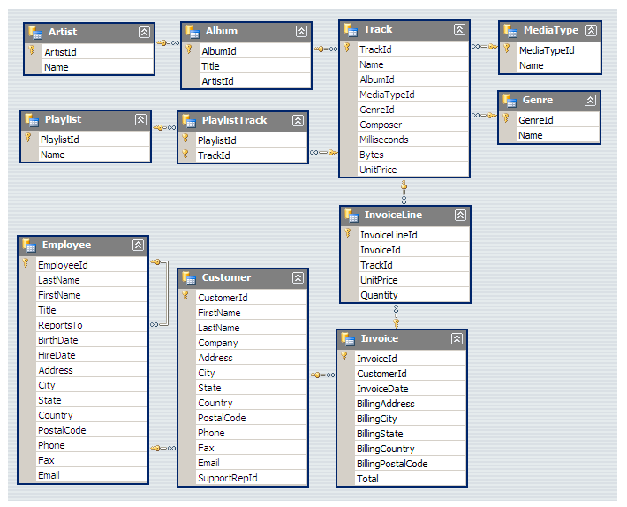
DATABASE SCHEMA

Slide 3
ANALYSIS QUESTIONS
Question Set 1 - Easy
Who is the senior most employee based on job title?
Which countries have the most Invoices?
What are top 3 values of total invoice?
Which city has the best customers? We would like to throw a promotional Music Festival in the city we made the most money. Write a query that returns one city that has the highest sum of invoice totals. Return both the city name & sum of all invoice totals
Who is the best customer? The customer who has spent the most money will be declared the best customer. Write a query that returns the person who has spent the most money

Slide 4
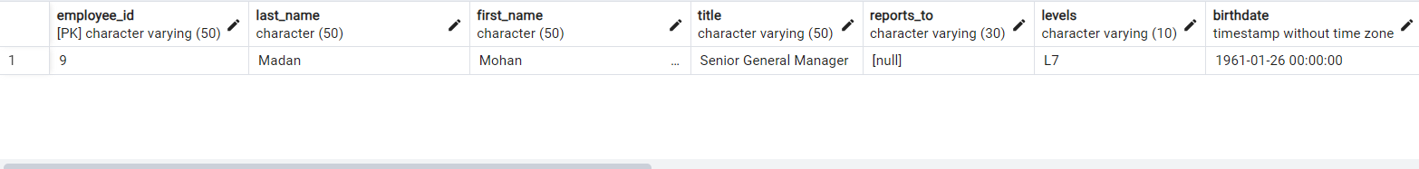
QUESTIONS SET 1
Who is the senior most employee based on job title?
Query:
Select * From employee
Order By levels Desc
Limit 1;
Output:

Slide 5
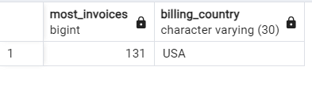
QUESTIONS SET 1
Which countries have the most Invoices?
Query:
Select count(*) As most_invoices, billing_country
From invoice
Group By billing_country
Order By most_invoices Desc
Limit 1;
Output:

Slide 6
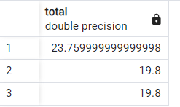
QUESTIONS SET 1
What are top 3 values of total invoice?
Query:
Select total
From invoice
Order By total Desc
Limit 3;
Output:

Slide 7

QUESTIONS SET 1
Which city has the best customers? We would like to throw a promotional Music Festival in the city. We made the most money. Write a query that returns one city that has the highest sum of invoice totals. Return both the city name & sum of all invoice totals
Query:
Select Sum(total) as total_invoice_count,
billing_city
From invoice
Group By billing_city
Order By total_invoice_count Desc
Limit 1;
Output:

Slide 8

QUESTIONS SET 1
Who is the best customer? The customer who has spent the most money will be declared the best customer. Write a query that returns the person who has spent the most money
Query:
Select t1.customer_id, t1.first_name,
t1.last_name,
Sum(t2.total) As total_amount_spent
From customer As T1
Join invoice As T2 on
t1.customer_id = t2.customer_id
Group By t1.customer_id
Order By total_amount_spent Desc
Limit 1;
Output:

Slide 9
ANALYSIS QUESTIONS
Question Set 2 - Moderate
Write query to return the email, first name, last name, & Genre of all Rock Music listeners. Return your list ordered alphabetically by email starting with A
Let's invite the artists who have written the most rock music in our dataset. Write a query that returns the Artist name and total track count of the top 10 rock bands
Return all the track names that have a song length longer than the average song length. Return the Name and Milliseconds for each track. Order by the song length with the longest songs listed first

Slide 10
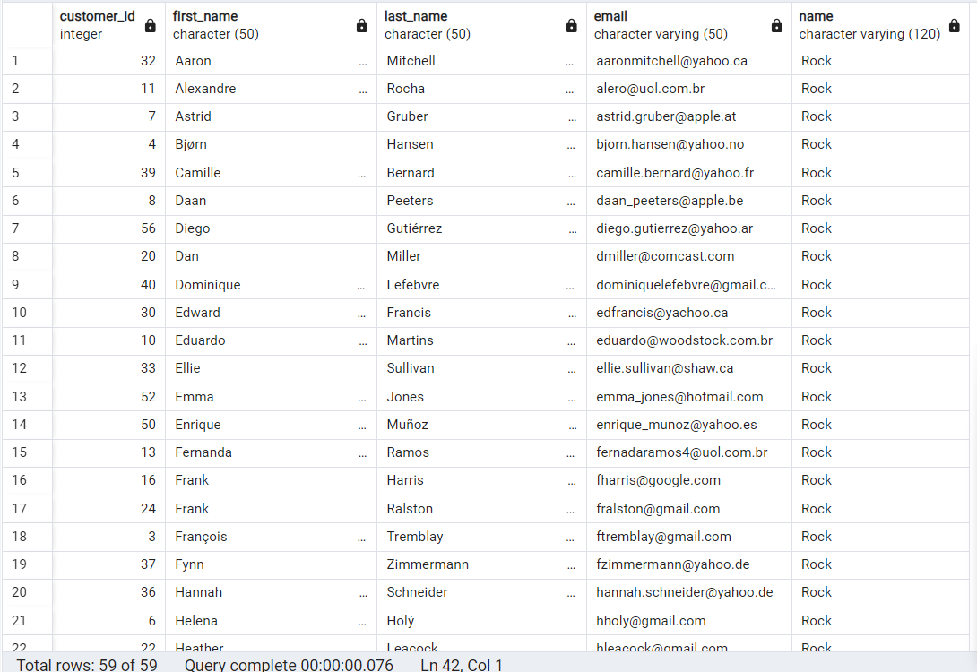
QUESTIONS SET 2
Write query to return the email, first name, last name, & Genre of all Rock Music listeners. Return your list ordered alphabetically by email starting with A
Query:
Select Distinct(t1.customer_id),
t1.first_name, t1.last_name,
t1.email, t5.name
From customer as T1
Join invoice as T2 On
t1.customer_id=t2.customer_id
Join invoice_line as T3 On
t3.invoice_id=t2.invoice_id
Join track as t4 On
t4.track_id = t3.track_id
Join genre as t5 On
t5.genre_id = t4.genre_id
Where t5.name = 'Rock’
Order By t1.email Asc;
Output:

Slide 11
QUESTIONS SET 2
Write query to return the email, first name, last name, & Genre of all Rock Music listeners. Return your list ordered alphabetically by email starting with A
Optimized Query:
SELECT
DISTINCT email, first_name, last_name
FROM customer AS c
JOIN invoice AS i ON
c.customer_id = i.customer_id
JOIN invoiceline AS il ON
i.invoice_id = il.invoice_id
WHERE track_id IN
(SELECT track_id
FROM track AS t
JOIN genre AS g ON
t.genre_id = g.genre_id
WHERE g.name LIKE 'Rock’)
ORDER BY email;
Output:

Slide 12
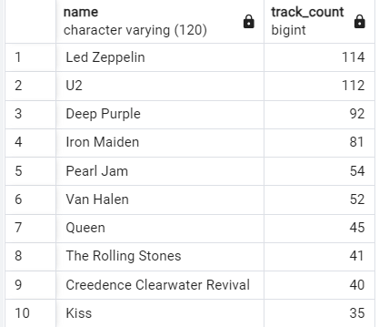
QUESTIONS SET 2
Let's invite the artists who have written the most rock music in our dataset. Write a query that returns the Artist name and total track count of the top 10 rock bands
Query:
Select
T1.name,
Count(T1.artist_id) as Track_Count
From artist As T1
Join album As T2 On
T1.artist_id = T2.artist_id
Join track As T3 On
T3.album_id = T2.album_id
Join genre As T4 On
T4.genre_id = T3.genre_id
Where T4.name Like 'Rock’
Group By T1.name
Order By Track_Count Desc
Limit 10;
Output:

Slide 13
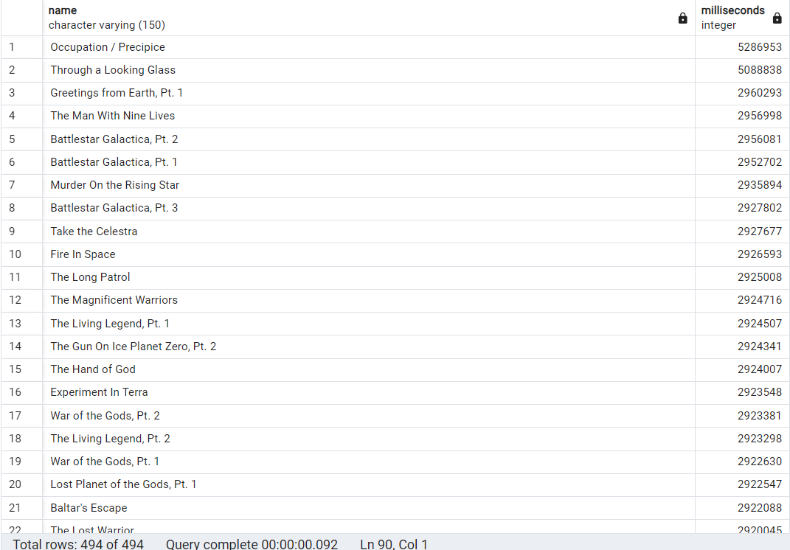
QUESTIONS SET 2
Return all the track names that have a song length longer than the average song length. Return the Name and Milliseconds for each track. Order by the song length with the longest songs listed first
Query:
Select
name,
milliseconds
From track
Where milliseconds> (
Select AVG(milliseconds) as average
From track)
Order By milliseconds Desc;
Output:

Slide 14
ANALYSIS QUESTIONS
Question Set 3 - Advance
Find how much amount spent by each customer on artists? Write a query to return customer name, artist name and total spent
We want to find out the most popular music Genre for each country. We determine the most popular genre as the genre with the highest amount of purchases. Write a query that returns each country along with the top Genre. For countries where the maximum number of purchases is shared return all Genres
Write a query that determines the customer that has spent the most on music for each country. Write a query that returns the country along with the top customer and how much they spent. For countries where the top amount spent is shared, provide all customers who spent this amount

Slide 15
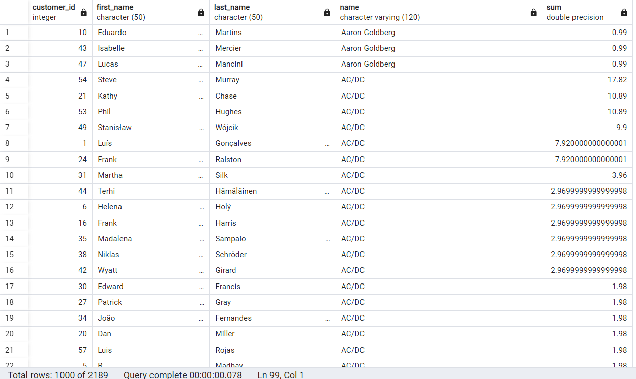
QUESTIONS SET 3
Find how much amount spent by each customer on artists? Write a query to return customer name, artist name and total spent
Query:
Select T1.customer_id, T1.first_name, T1.last_name, T6.name,
Sum(T3.unit_price * T3.quantity) As Total_Money_Spent
From customer as T1
Join invoice as T2 On
T1.customer_id = T2.customer_id
Join invoice_line as T3 On
T3.invoice_id = T2.invoice_id
Join track as T4 On
T4.track_id = T3.track_id
Join album as T5 On
T5.album_id = T4.album_id
Join artist as T6 On
T6.artist_id = T5.artist_id
Group By 1,2,3,4
Order By 4 Asc, 5 Desc;
Output:

Slide 16
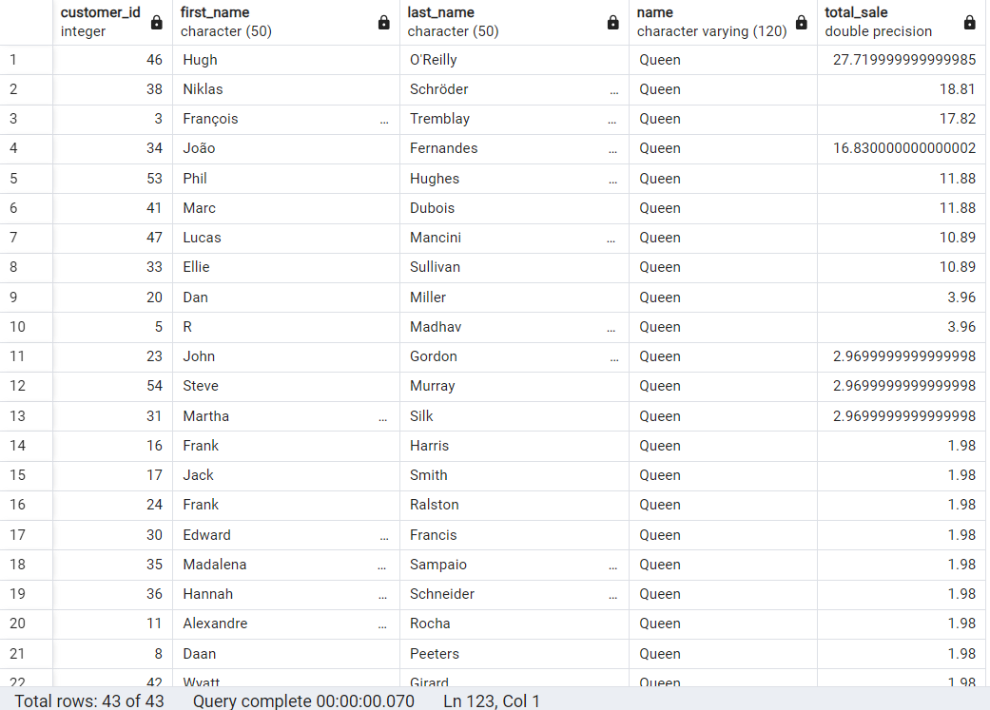
QUESTIONS SET 3
Find how much amount spent by each customer on artists? Write a query to return customer name, artist name and total spent
Query (only best selling artist):
With best_selling_artist As (
Select A.artist_id, A.name,
Sum(Il.unit_price*Il.quantity) from artist as A
Join
Album As Al On A.artist_id = Al.artist_id
Join
Track As T On Al.album_id = T.album_id
Join
Invoice_line As Il On T.track_id = Il.track_id
Group By 1,2
Order By 3 Desc
Limit 1)
Select T1.customer_id, T1.first_name, T1.last_name, T6.name,
Sum(T3.unit_price*T3.quantity) As Total_Sale
Output:

Slide 17
QUESTIONS SET 3
Find how much amount spent by each customer on artists? Write a query to return customer name, artist name and total spent
Query (only best selling artist) Continue:
From customer As T1
Join
invoice As T2 On T1.customer_id = T2.customer_id
Join
invoice_line As T3 On T3.invoice_id = T2.invoice_id
Join
track As T4 On T4.track_id = T3.track_id
Join
album As T5 On T5.album_id = T4.album_id
Join
best_selling_artist As T6 On T6.artist_id = T5.artist_id
Group By 1,2,3,4
Order By 4 Asc, 5 Desc;
Output:

Slide 18
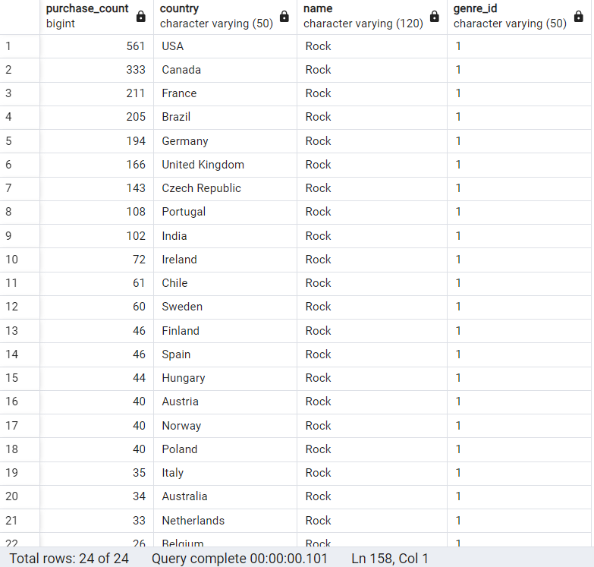
QUESTIONS SET 3
We want to find out the most popular music Genre for each country. We determine the most popular genre as the genre with the highest amount of purchases. Write a query that returns each country along with the top Genre. For countries where the maximum number of purchases is shared return all Genres
Query:
With Recursive
find_purchase_count As (
Select Count(*) As purchase_count,
c.country, g.name, g.genre_id
From invoice_line As il
Join
invoice As i On i.invoice_id = il.invoice_id
Join
customer As c On c.customer_id = i.customer_id
Join
track As t On t.track_id = il.track_id
Join
genre As g On g.genre_id = t.genre_id
Group By 2,3,4
Order By 2 ),
Output:

Slide 19
QUESTIONS SET 3
We want to find out the most popular music Genre for each country. We determine the most popular genre as the genre with the highest amount of purchases. Write a query that returns each country along with the top Genre. For countries where the maximum number of purchases is shared return all Genres
Query(Continue):
max_purchase_count As(
Select Max(purchase_count) As M_purchase_count,country
From find_purchase_count
Group By 2
Order By 2)
Select pc.*
From find_purchase_count As pc
Join
max_purchase_count As mpc On pc.country = mpc.country
Where pc.purchase_count = mpc.M_purchase_count
Order By purchase_count Desc;
Output:

Slide 20
QUESTIONS SET 3
We want to find out the most popular music Genre for each country. We determine the most popular genre as the genre with the highest amount of purchases. Write a query that returns each country along with the top Genre. For countries where the maximum number of purchases is shared return all Genres
Query (Using CTE):
With max_purchase_count As(
Select Count(*) As purchase_count, c.country, g.name, g.genre_id,
Row_Number() Over(Partition By (c.country) Order By Count(il.quantity) Desc) As RowNo
From invoice_line as il
Join
invoice As i On i.invoice_id = il.invoice_id
Join
customer As c On c.customer_id = i.customer_id
Join
track As t On t.track_id = il.track_id
Join
genre As g On g.genre_id = t.genre_id
Group By 2,3,4
Order By 2)
Select purchase_count, country, name, genre_id
From max_purchase_count
Where RowNo=1
Order By purchase_count Desc;
Output:

Slide 21
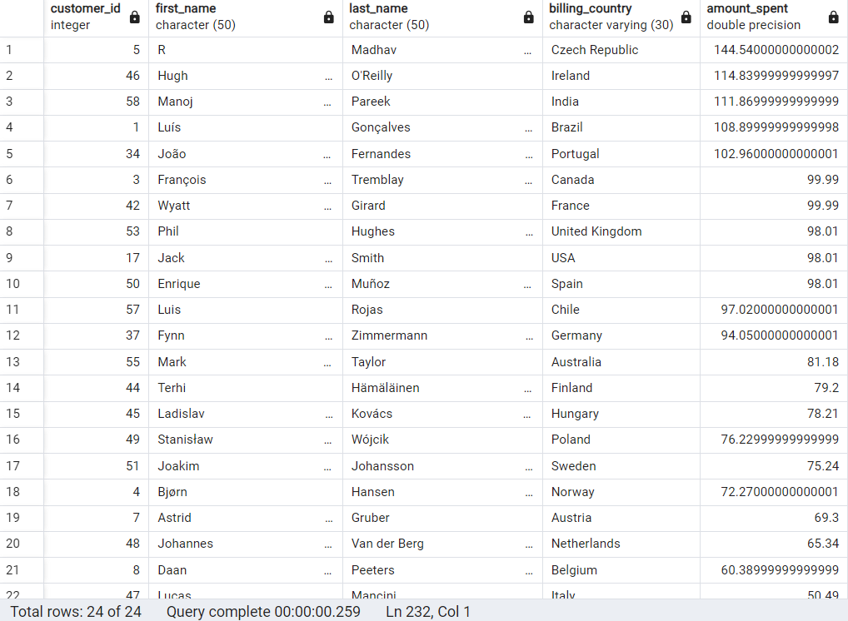
QUESTIONS SET 3
Write a query that determines the customer that has spent the most on music for each country. Write a query that returns the country along with the top customer and how much they spent. For countries where the top amount spent is shared, provide all customers who spent this amount
Query:
With Recursivecustomer_spending As (
Select c.customer_id, c.first_name, c.last_name, i.billing_country,
Sum(i.total) As amount_spent
From invoice As i
Join customer As c On c.customer_id = i.customer_id
Group By 1,2,3,4
Order By 1, 5 Desc),
max_amount_spent As (
Select Max(amount_spent) As M_amount_spent, billing_country
From customer_spending
Group by 2
Order by 2 )
Select cs.* Fromcustomer_spending As cs
Join max_amount_spent As mas On cs.billing_country = mas.billing_country
Where cs.amount_spent = mas.M_amount_spent
Order By 5 Desc;
Output:

Slide 22
QUESTIONS SET 3
Write a query that determines the customer that has spent the most on music for each country. Write a query that returns the country along with the top customer and how much they spent. For countries where the top amount spent is shared, provide all customers who spent this amount
Query (Using CTE):
With max_amount_spent As (
Select c.customer_id, c.first_name, c.last_name, i.billing_country,
Sum(i.total) As amount_spent,
Row_Number() Over(Partition By (i.billing_country)
Order By Sum(i.total) Desc) As RowNo
From invoice As i
Join customer As c On c.customer_id = i.customer_id
Group By 1,2,3,4
Order By 1, 5 Desc )
Select customer_id, first_name, last_name, billing_country, amount_spent
From max_amount_spent
Where RowNo=1
Order By amount_spent Desc;
Output:

